Slide 1

A lightning threat index for Southern Africa using numerical weather prediction data
SWFDP 2015
Morné Gijben
South African Weather Service
Email correspondence: morne.gijben@weathersa.co.za

Slide 2
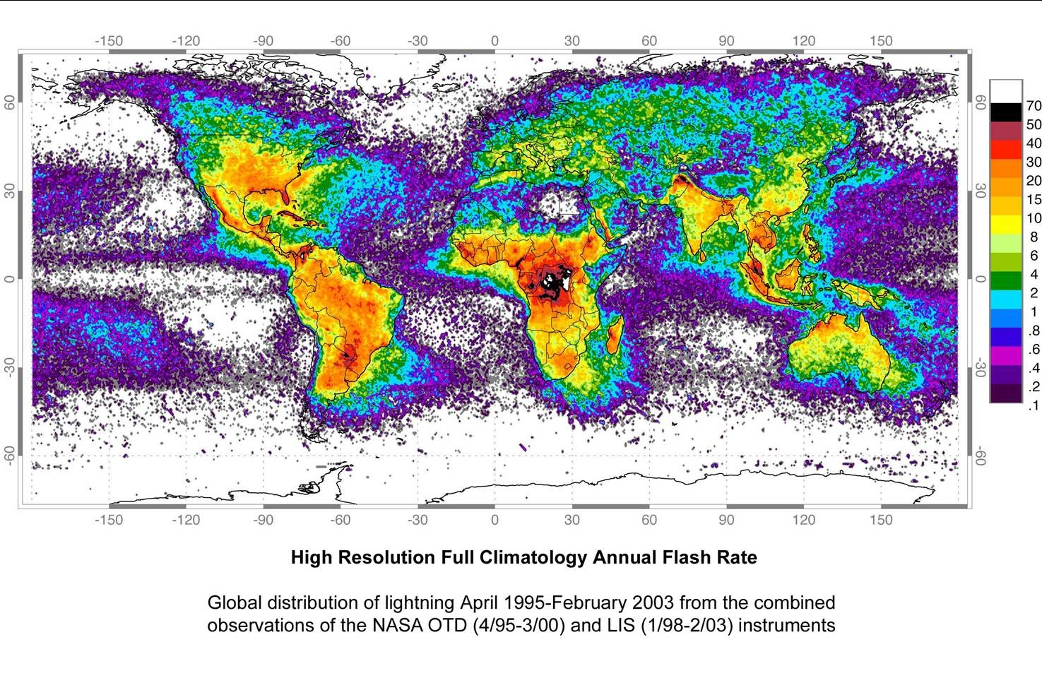
Introduction
Africa is a lightning prone country

Slide 3
Introduction
Lightning causes numerous deaths and injuries each year
  Estimated 24 000 deaths annually
  Estimated 240 000 injuries
Insurance claims due to lightning amount to millions of dollars each year
  > $1 billion in the USA
  > R 500 million in SA
A large percentage of power outages reported by power utilities are due to lightning
Many more…
There is a need to forecast the areas where lightning can be a threat to ensure the protection of people and property.

Slide 4
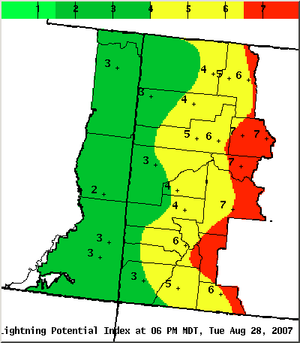
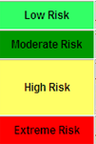
Introduction
The NWS Grand Junction office in Colorado developed a product that uses numerical weather prediction model fields to calculate a lightning potential index (LPI).
The product gives an outlook for the day of where the lightning threat can be considered high.
Source: http://www.crh.noaa.gov/gjt/?n=lightningpotentialindex

Slide 5
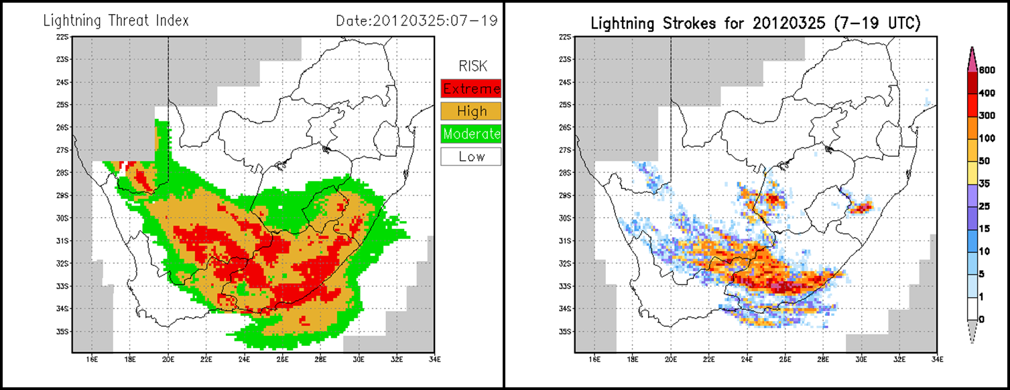
Introduction
Previously it was shown that the NWS LPI can be useful to identify the areas where lightning may occur in SA
This LPI was however designed for conditions in the USA and with a different NWP model.

Slide 6
Introduction
The aim of this study was:
  To determine which parameters (similar to that used in the LPI) is best to predict lightning in SA.
  To develop a new Lightning Threat Index (LTI) for SA conditions from NWP fields by using the local version of the Unified Model (UM)

Slide 7
Data & Methods
Numerical weather prediction data was obtained from the Unified Model at SAWS.
Lightning data was obtained from the lightning detection network at SAWS.
The data was extracted for three SON (spring) and DJF (summer) seasons.
  2011, 2012 and 2013 SON periods.
  2011/12, 2012/13 and 2013/14 DJF periods.

Slide 8
Data & Methods
Lightning was the dependent variable (observation) in this study. If lightning occurred in a grid box, it was given a value of 1, and a value of 0 if no lightning occurred.
The model parameters were the independent variables and were used to predict the binary outcome of the dependent variable.
Six main groups of model parameters were considered for the development of the LTI, namely: CAPE, PW, T, LI, ΘeΓ, RH.
For each of the groups, different variations were selected from literature that proved useful for lightning predictions.

Slide 9
Parameter Selection
The first goal was to select the best parameter out of 6 groups (similar to original LPI).
Convective Available Potential Energy
1 | Surface CAPE | muCAPE (1-6 km AGL)
 | muCAPE (0-3 km AGL) | muCAPE (lowest 300 hPa)
Precipitable Water
2 | Mean PW (850-300 hPa) |  | Mean PW (700-400 hPa)
Temperature
3 | T (1.5 m AGL) |  | T (700 hPa)
 | Mean T (850-700 hPa) |  | Mean T (500 – 300 hPa)
Lifted Index
4 | Lifted Index |  | Best Lifted Index
Equivalent Potential Temperature
5 | ƟeΓ (850-400 hPa) |  | ƟeΓ (850 - 500 hPa)
 | ƟeΓ (700-500 hPa) |  | ƟeΓ (600 hPa)
 | ƟeΓ (1-6 km AGL) |  | ƟeΓ (-10˚C to -20˚C)
 | Surface Ɵe
Relative Humidity
6 | RH (at -10˚C) |  | Ave RH (-12˚C to -18˚C)
 | Ave RH (3-6 km AGL) |  | Max RH (3-6 km AGL)
 | Min RH (3-6 km AGL)

Slide 10
Parameter Selection
SAS statistical software
  Penalized Likelihood Method was utilized
  Each of the parameters from the main groups were added to the model one-by-one.
  The parameter with the highest chi-square value performed the best to predict lightning.
R software
  Stepwise logistical regression was utilized
  Each of the parameters from the main groups were added to the stepwise regression one-by-one
  The parameter with the lowest Akaike Information Criterion (AIC) performed the best to predict lightning.

Slide 11
Parameter Selection
The table below shows the parameters selected for SON + DJF periods which was identified by SAS and R to be the best parameters for lightning prediction.
Parameters highlighted in yellow differ between seasons
SON | DJF
muCAPE (1-6 km AGL) | muCAPE (1-6 km AGL)
Lifted Index | Lifted Index
Mean PW (850 - 300 hPa) | Mean PW (850 - 300 hPa)
Min RH (3 - 6 km AGL) | Ave RH (3 - 6 km AGL)
ƟeΓ (700 - 500 hPa level) | ƟeΓ (850 - 400 hPa level)
Mean T (850 - 700 hPa) | Mean T (850 - 700 hPa)

Slide 12
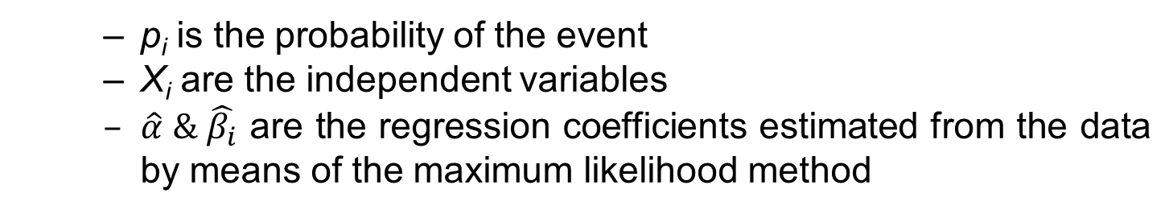
Development of LTI
The LTI was developed by means of binary logistical regression which predicts the probability that an event will or will not occur.

Slide 13
Development of LTI
It was found that ordinary logistical regression underestimates the probabilities of lightning
This is due to the logistical regression favouring the larger amount of non-events (0’s) compared to the smaller amount of events (1’s) when training the model.
King and Zeng (2001) found a similar problem with the logistical regression of rare-events and developed a methodology to solve this issue (R-package – ‘Zelig’).
There are three steps in the rare event logistical regression:
  Make use of endogenous stratified sampling where all the events are taken together with a random sample of non-events.
  A correction to avoid the sampling bias on the intercept
  Underestimation of probabilities is taken into account by adding a correction term to the estimated probabilities

Slide 14
Development of LTI
In the development of the LTI, the following procedure was followed for the rare event logistical regression:
  Take all events (1’s) in the dataset and select a random sample of an equal amount of non-events (0’s).
  Run the ‘Zelig’ package to perform a rare event logistical regression with the bias correction and addition of the correction term.
  Repeat the process 1000 times by selecting a new sample of non-events (0’s). The samples are taken with repetition, where the 0’s in the previous sample is added back into the dataset where there is the possibility that they can be chosen again.
The 1000 models are then combined by averaging their output (bootstrapping).

Slide 15
Development of LTI
The LTI is given by the following equation:
SON |  | DJF
A | 81.2564450094 | A | 96.3739728597
B | -0.0000341603 | B | -0.0003621305
C | 1.8711318175 | C | 1.6498509643
D | -0.3075713873 | D | -0.2744099332
E | -0.2004598804 | E | -0.2538438647
F | 0.0218575175 | F | 0.0228283828
G | -0.3076425065 | G | -0.3646825175

Slide 16
SA cases

Slide 17
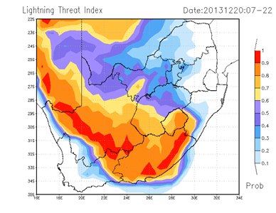
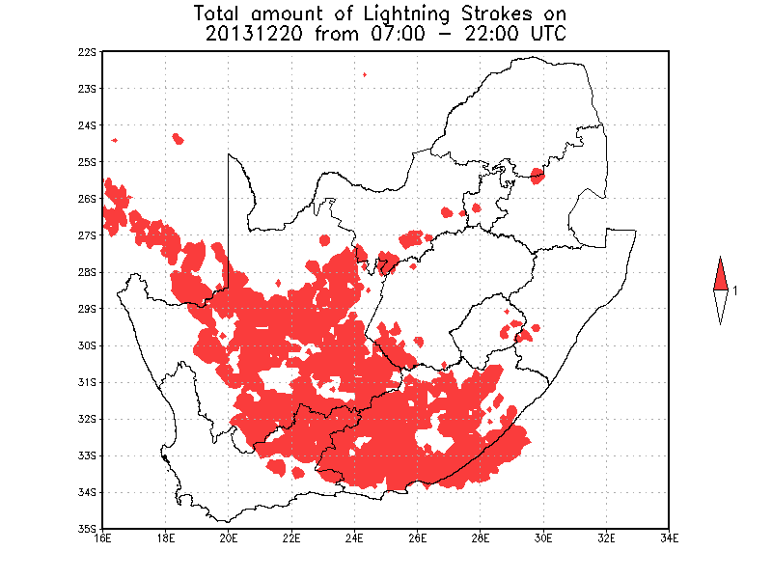
20 December 2013

Slide 18
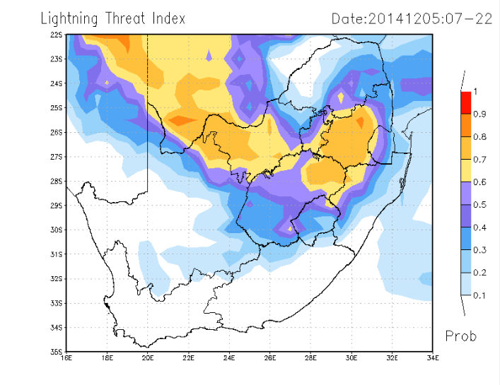
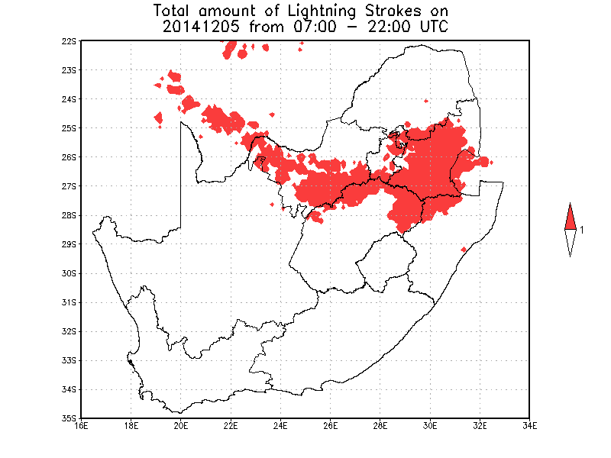
5 December 2014

Slide 19
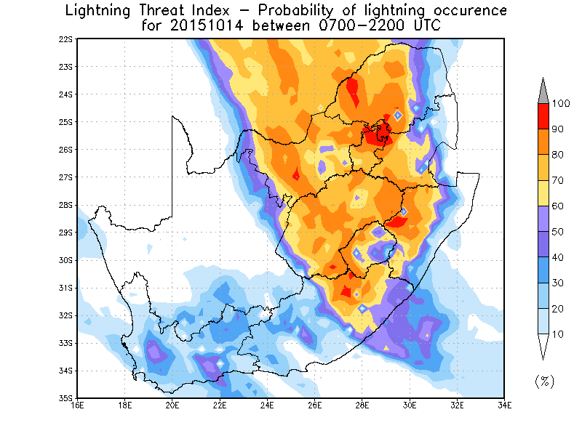
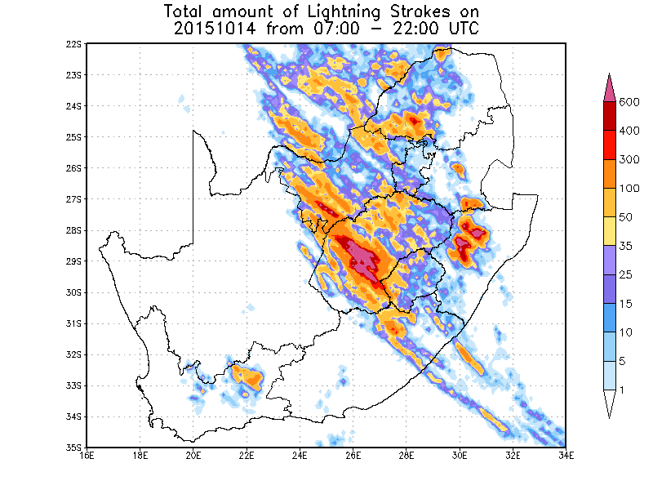
14 October 2015

Slide 20
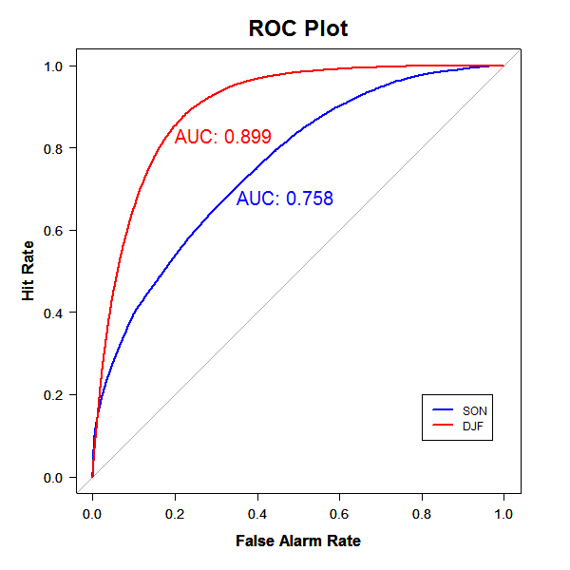
Results

Slide 21
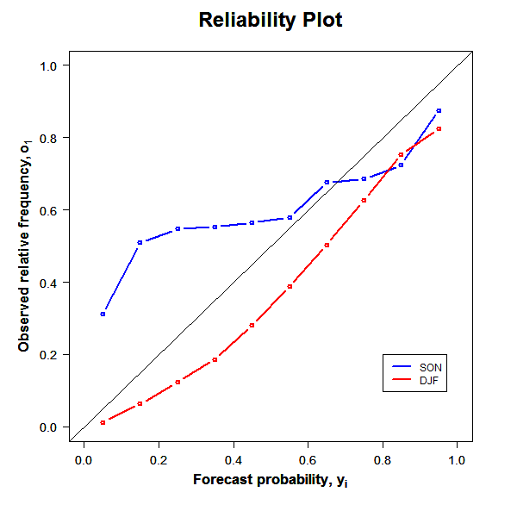
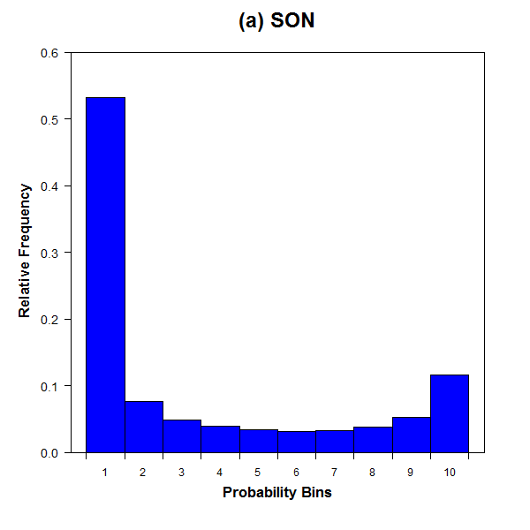
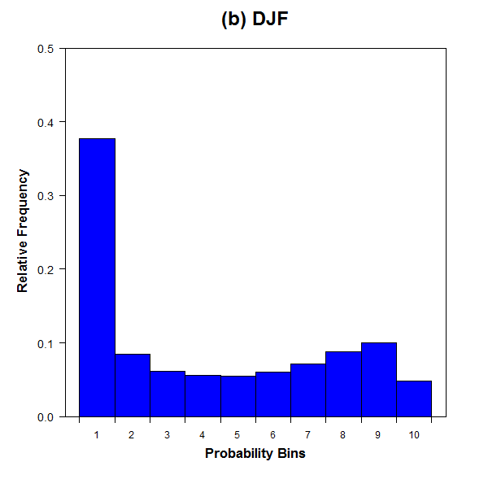
Results

Slide 22
SADC cases

Slide 23
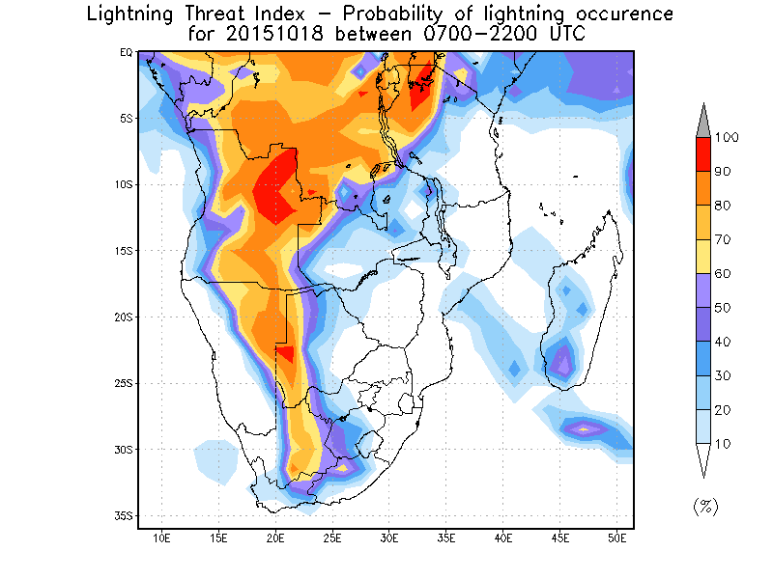
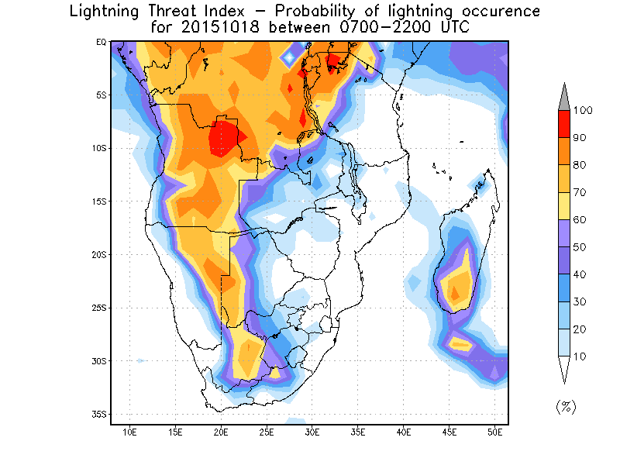
18 October 2015
17 Oct forecast for 18 Oct
18 Oct forecast

Slide 24
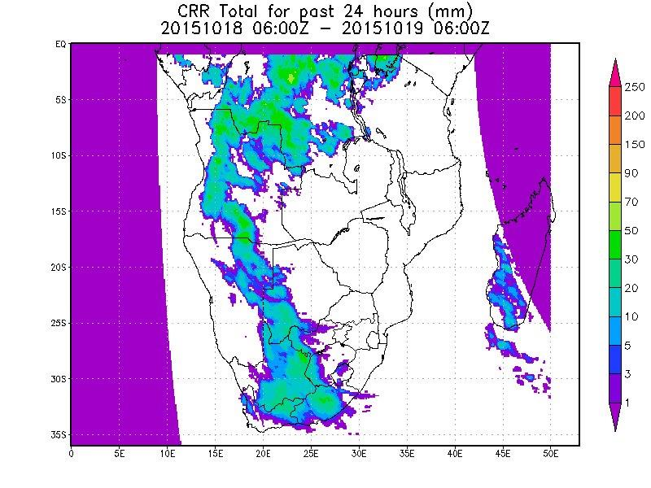
18 October 2015

Slide 25
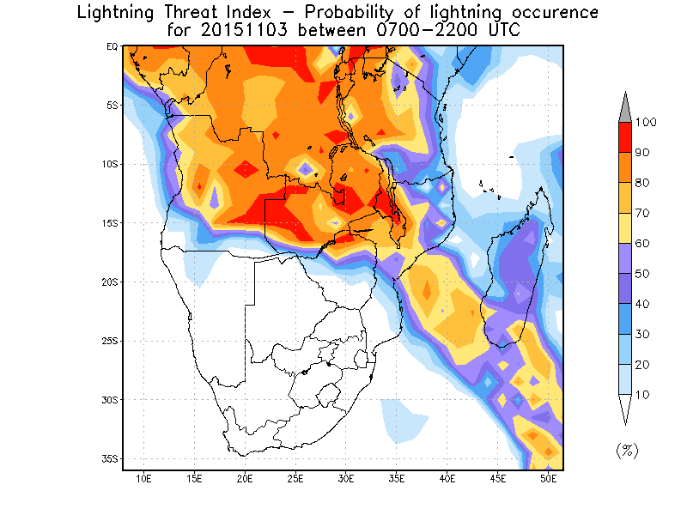
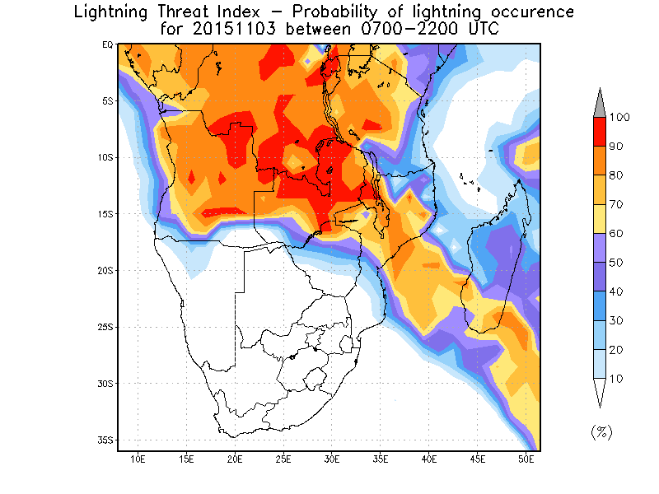
3 November 2015
2 Nov forecast for 3 Nov
3 Nov forecast

Slide 26
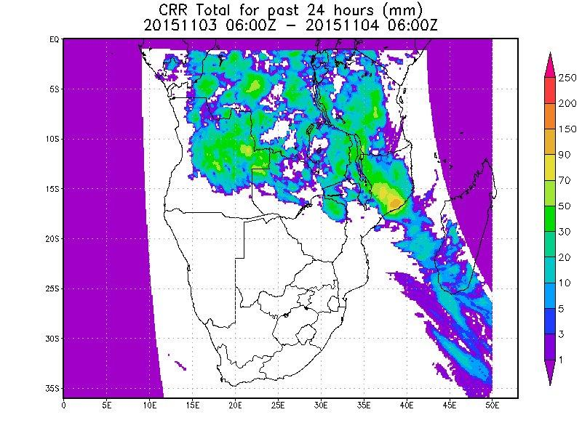
3 November 2015

Slide 27
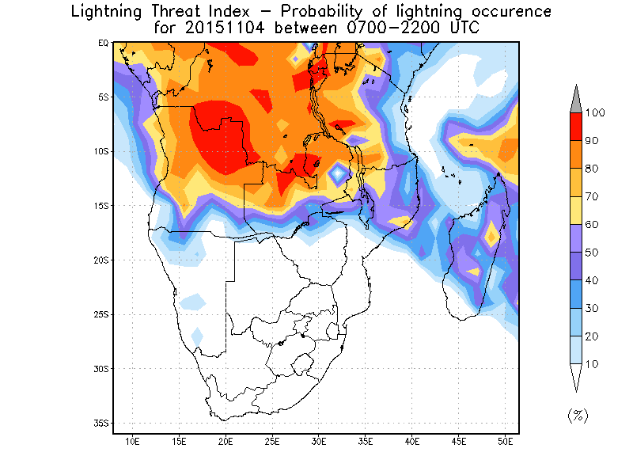
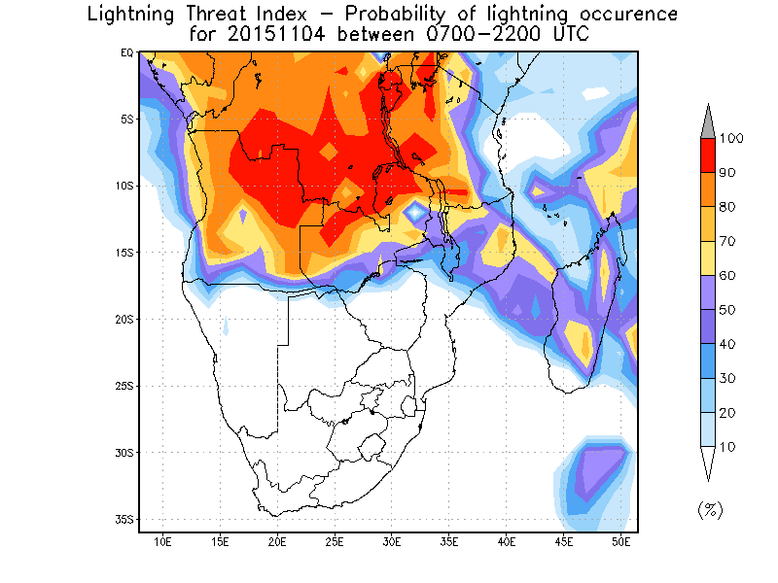
4 November 2015
3 Nov forecast for 4 Nov
4 Nov forecast

Slide 28
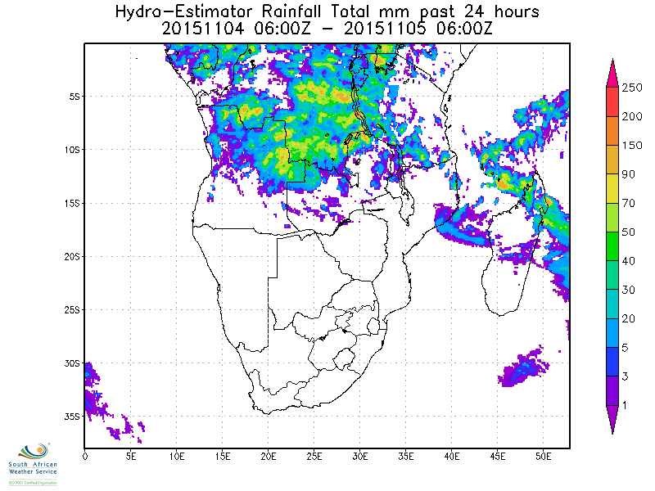
4 November 2015

Slide 29
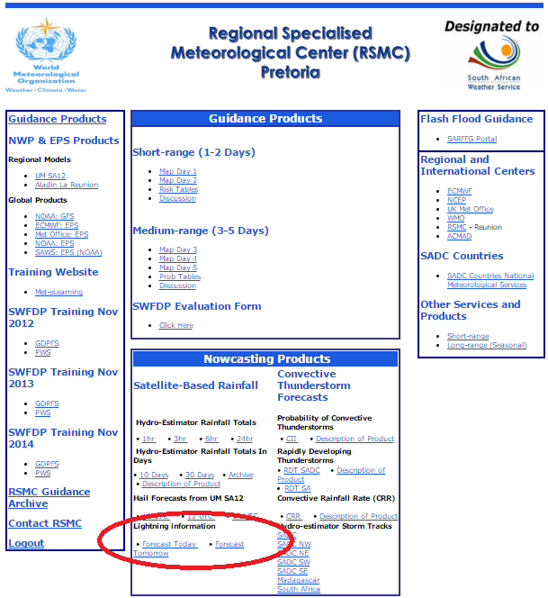
RSMC website
Available on RSMC website at ~06:45 GMT

Slide 30
Conclusions
A new NWP-based LTI was developed for SA.
Verification indicates that the LTI discriminates well between areas where lightning did and did not occur.
The LTI was also extended to cover the SADC region
Forecast for day 1 and day 2 available at ~06:45 UTC
The LTI can be a valuable additional tool to implement operationally to weather forecasters.

Slide 31
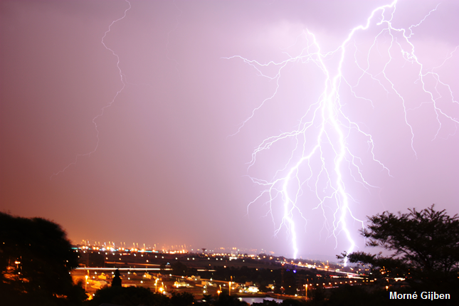
Thank you!

